Slide 1

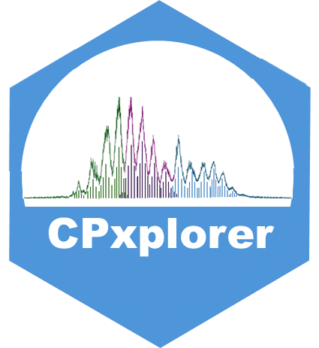
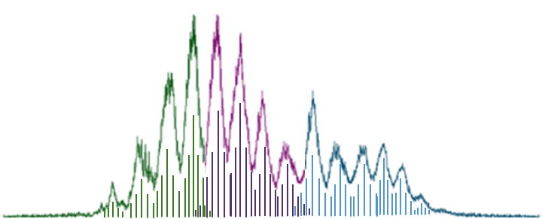
CPxplorer
https://github.com/WBS-TW/CPxplorer
A platform-independent toolkit for rapid quantification and harmonization of polychlorinated alkanes

Slide 2




CPxplorer
https://github.com/WBS-TW/CPxplorer
WORKFLOW
1
CREATE A TARGET LIST
CPion
CPion is a graphical user interface that allows exploring mass spectral interferences and creating a target ion list, which excludes the interfering m/z values
2
INTEGRATE THE DATA
Skyline
Skyline is open-source software that allows integrating the mass spectrometric data based on the target list created by CPion and does not necessitate prior data conversion
3
QUANTIFY THE DATA
CPquant
CPquant is a graphical user interface that allows quantifying the integration results from Skyline using the homologue deconvolution method
CONTACT INFORMATION:
idoia.beloqui.ezquer@liu.se
thanh.wang@liu.se

Slide 3
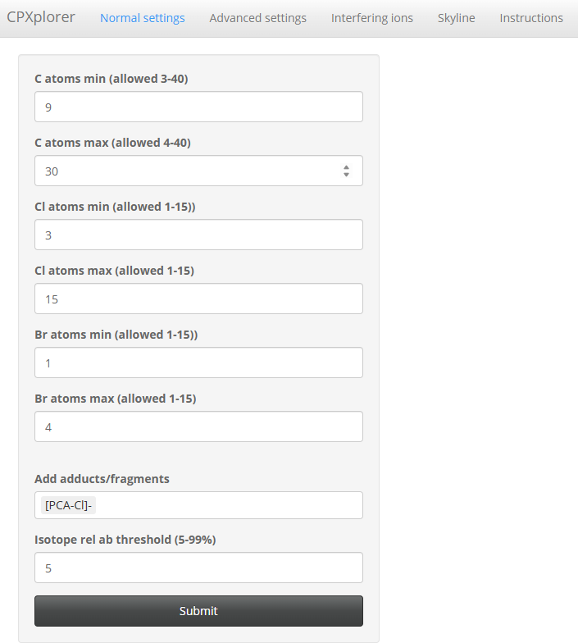
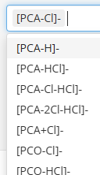
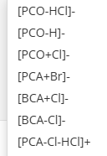
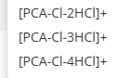

CPxplorer
CPion
CREATE A TARGET LIST
CPion is a module part of the CPxplorer package. It consists of an Rstudio based app whose code source can be found at https://github.com/WBS-TW/CPxplorer. It can also be opened directly on the browser at https://wbs-tw.github.io/CPions_Shinylive/, and this method does not require to be downloaded and installed.
CPion is a tool for exploring mass spectral interferences of compounds that are present at chlorinated paraffin (CP) mixtures, including polychlorinated alkanes (PCAs), brominated alkanes (BCAs), polychlorinated olefins (PCOs) and PCA- transformation products.
The user can select the compounds to be investigated at the initial window of CPion, “Normal setting”:
*
Select the carbon chain length, and, chlorination and bromination degree
Select the adduct(s)
CALCULATE THE INTERFERENCES
Only the m/z values that have a relative abundance above the threshold will be generated
*
BCAs and PCA transformation products can be generated at the “Advanced setting” window
1

Slide 4
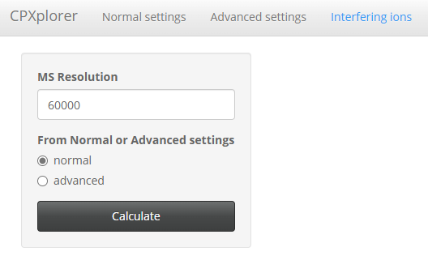
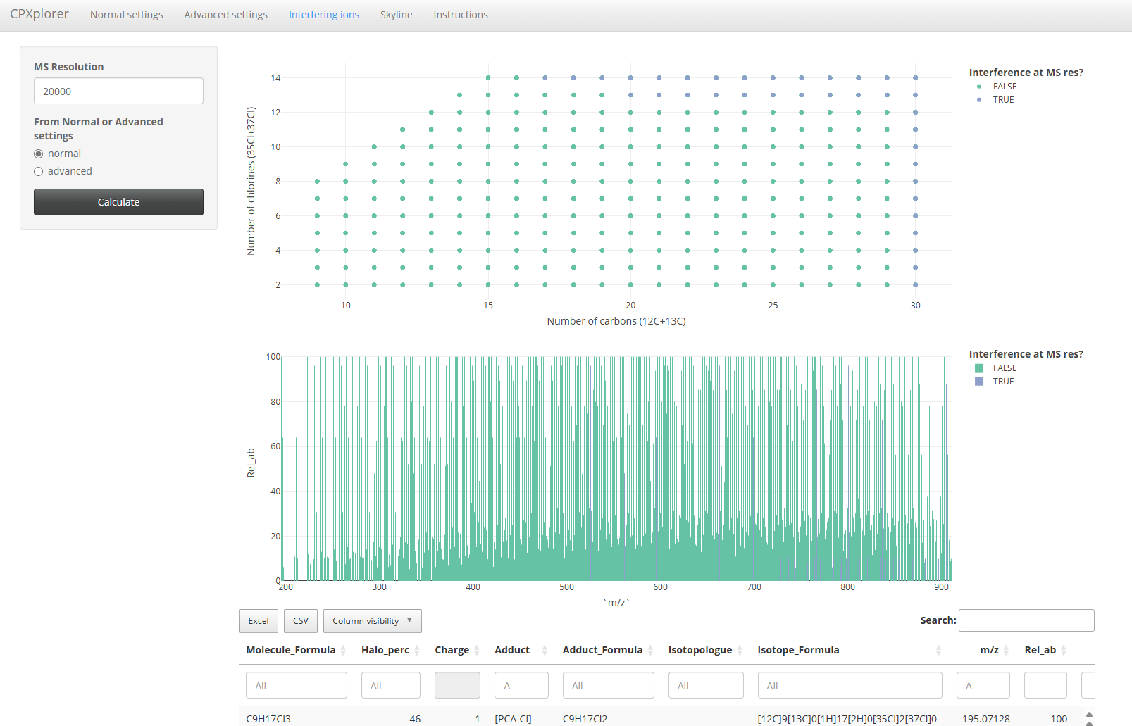
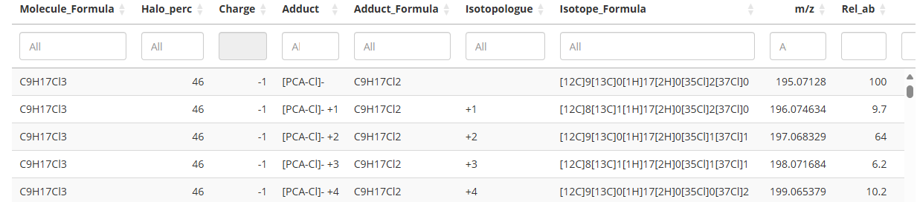
CPxplorer
CPion
CREATE A TARGET LIST
The ions that fit the selected parameters will be generated and compiled in a table at the “Normal settings” window. The interferences between the m/z values can be investigated at the “Interfering ions” window:
Select the instrumental resolution that want to be applied
Select the settings that want to be investigated
CALCULATE THE INTERFERENCES
The interferences will be displayed in interactive graphs and table:
“TRUE” ions are expected to interfere
Interferences displayed by molecular formula
Interferences displayed by m/z values
“TRUE” ions are expected to interfere
Compilation of all ions and their interferences
2

Slide 5
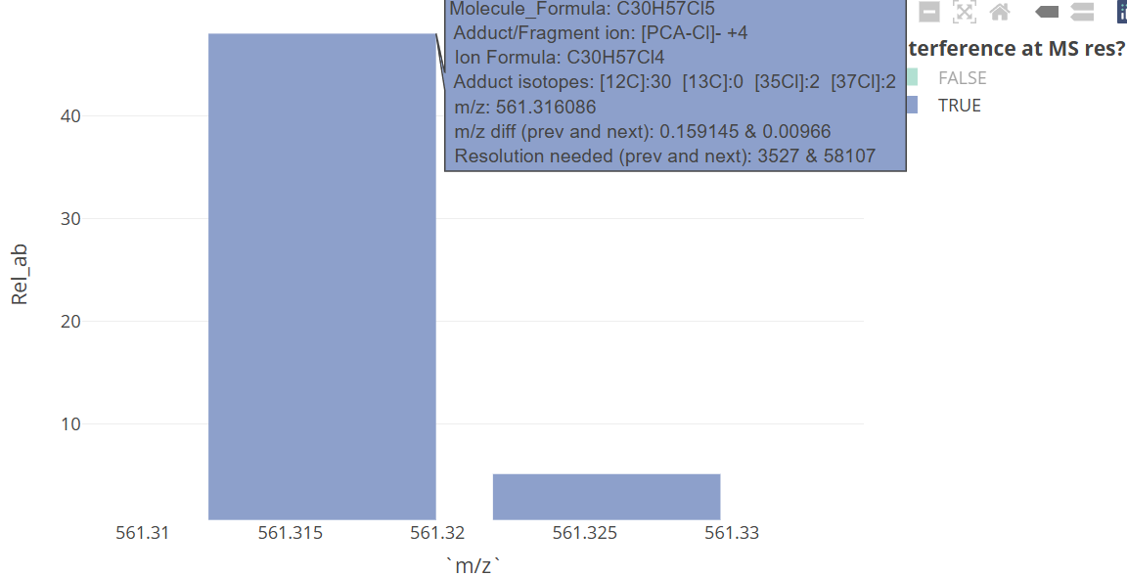
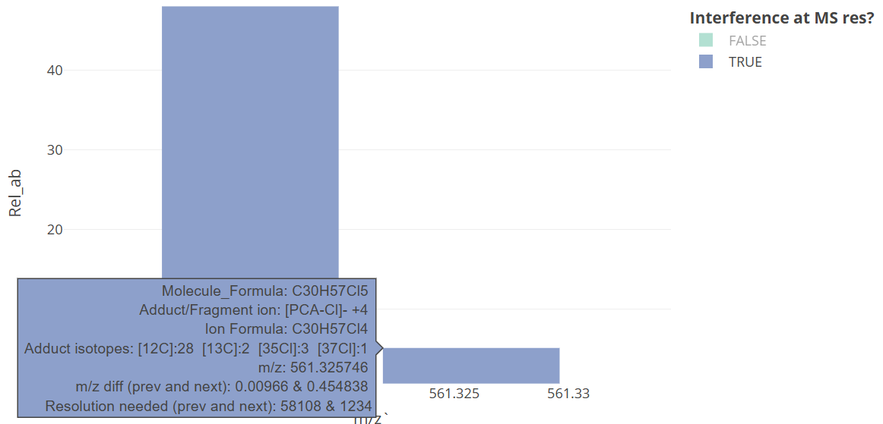
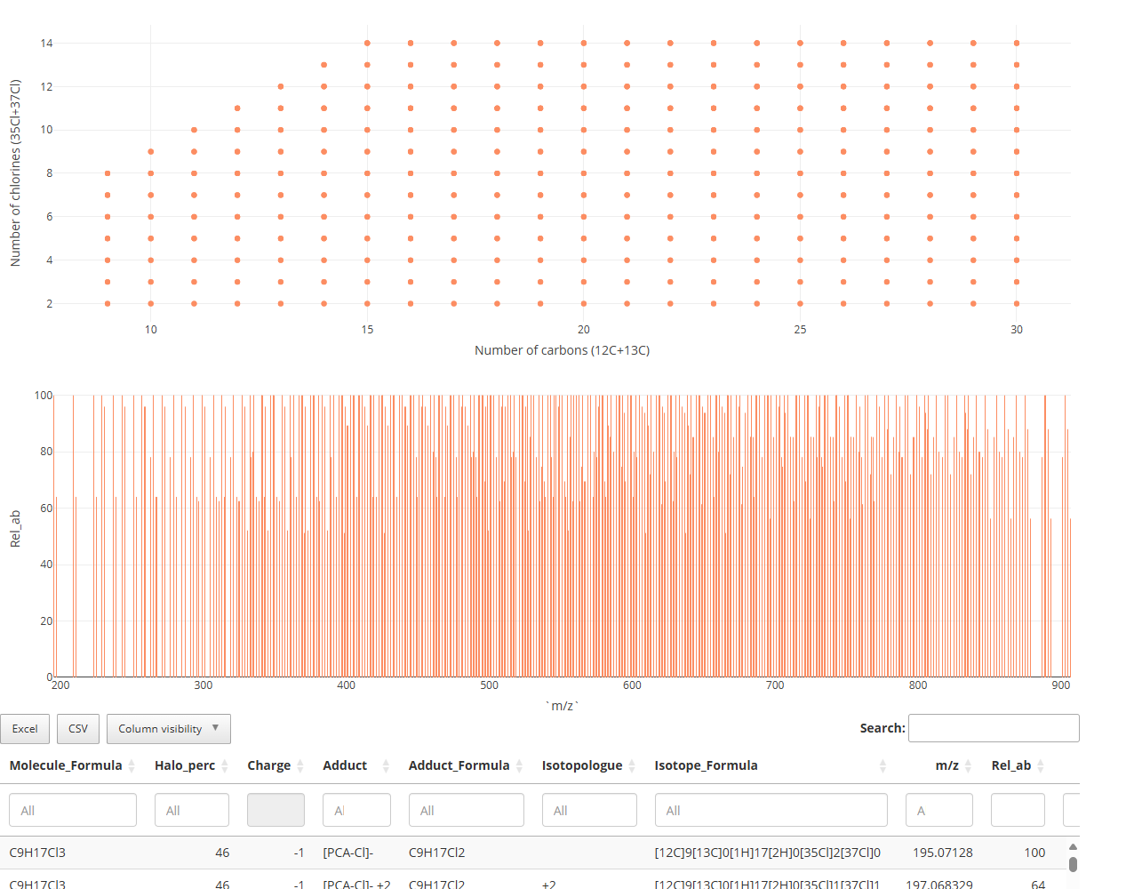
CPxplorer
CPion
CREATE A TARGET LIST
The graphs can be zoomed in and more information about the interfering ions will be displayed. This allows the user to understand the interferences better and select the target ions. As explained in the following example:
Some of the [C30H57Cl4 -Cl]⁻ +4 isotopes can interfere with each other. The ion with m/z 562.325746 has a relative abundance below 10. If the user sets the threshold in the previous tab above it, it will exclude this ion from the target list
The user can then return to the “Normal setting” window, set a higher relative abundance threshold, calculate the ions above it, and investigate their interferences.
The theoretical relative abundances of some interfering ions are very low, making them unlikely to be significant. The user should set a relative abundance threshold higher than that of these ions, ensuring that at least three isotopomers are considered for each homologue group:
No interferences are expected at the MS resolution and above the selected relative abundance threshold
No interferences are expected at the MS resolution and above the selected relative abundance threshold
3

Slide 6
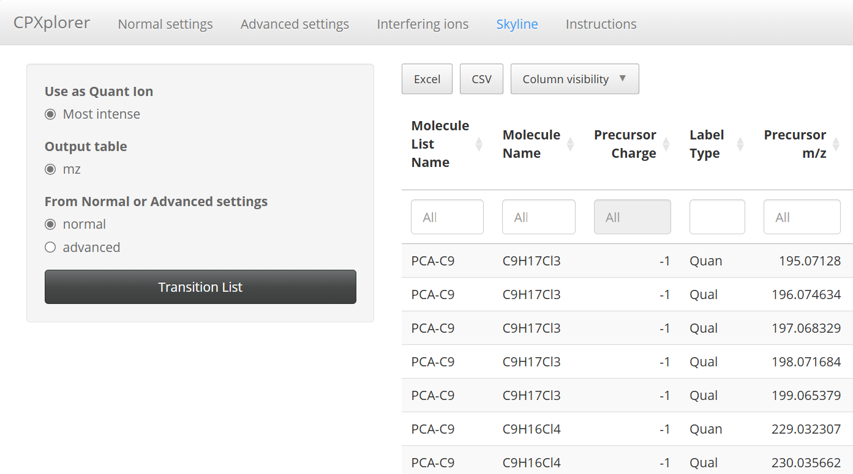
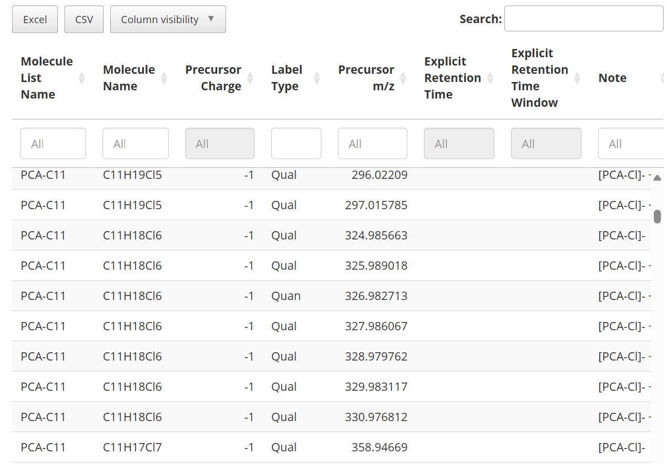
CPxplorer
CPion
CREATE A TARGET LIST
Once the user has selected the target ions, the target list can be created at the “Skyline” window.
The ion with the highest relative abundance will be considered as the quantitative ion *
Select the settings that want to be used to generate the transition list
GENERATE THE TARGET LIST
The target list can be modified by the user, and it can exported to Excel or CSV files.
The list including the target compounds is named “Transition list” in Skyline it will be used to extract the ion chromatograms from the raw data in the next step.
* The user can manually change Quan/Qual in the exported file
4

Slide 7
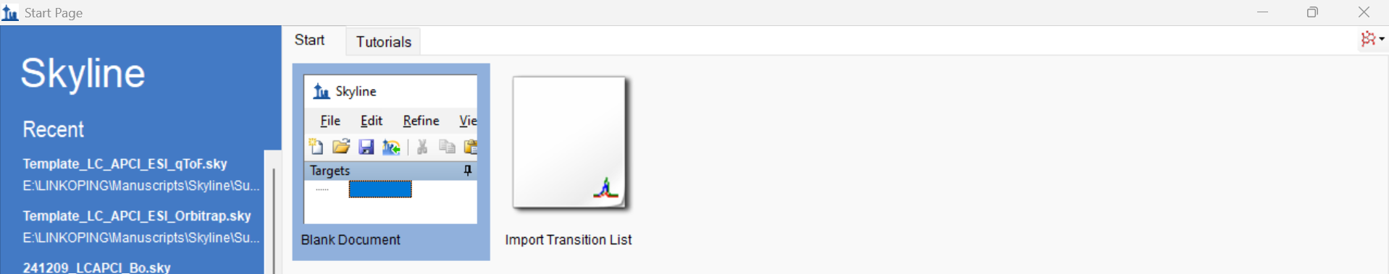
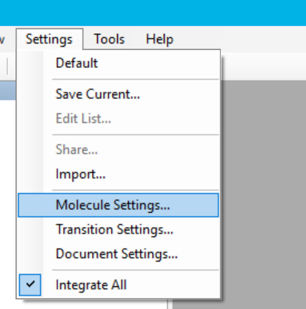
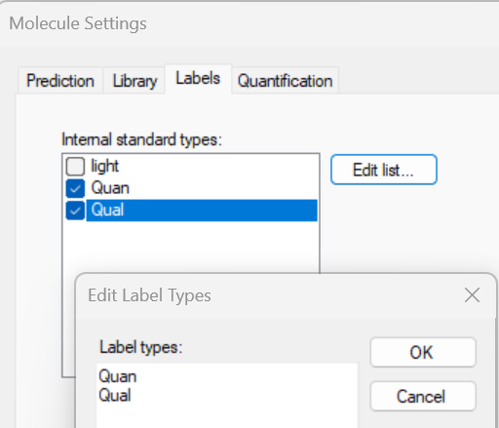
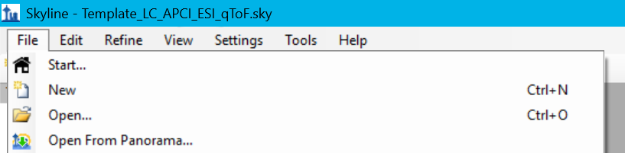
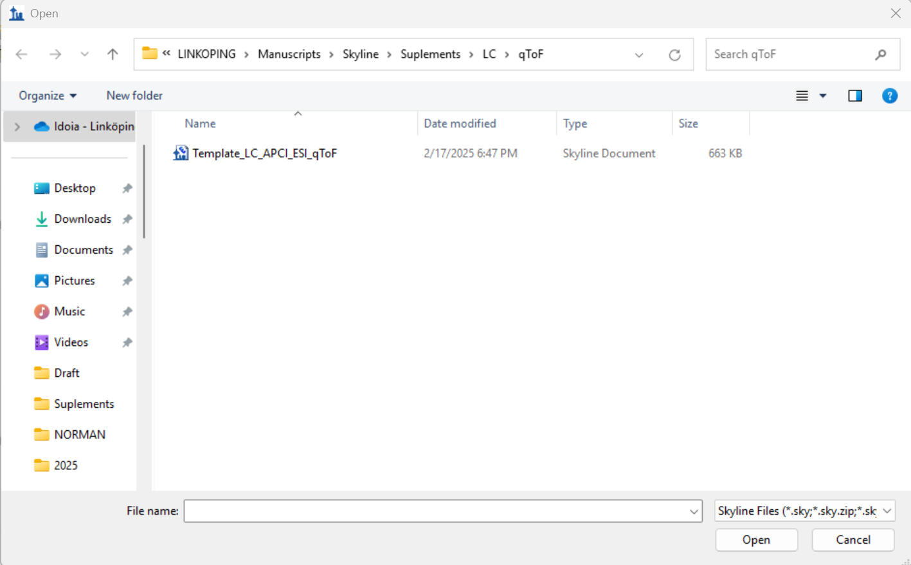
CPxplorer
Skyline
INTEGRATE THE DATA
The next step of the CPxplorer workflow is conducted in Skyline, an open-source Windows client software for treating mass spectrometric data. Skyline can be freely downloaded at the following link:
https://skyline.ms/project/home/software/skyline/begin.view. The following sections provide instructions on using Skyline 24.1..
Since Skyline can be used for the analysis of proteomics and small molecules, the first step is to set the software interface to “Molecule interface”. Then a Blank Document can be created:
Set the software interface to “Moleclule interface”
Create a Blank Document
Prior to updating the data into Skyline, the settings for extracting the data must be selected. The “Molecule setting” offers the possibility of labeling the ions and identifying which one is the quantitative one.
Select the labels “Quan” and “Qual”, if they do not appear on the display, “Edit list” and manually add these two labels
Instrumental settings for data from different chromatographic and mass spectrometric instruments can be found at: https://github.com/WBS-TW/CPxplorer.
The method can be opened in Skyline. The settings will be then set, and the .raw data can be directly uploaded into Skyline. The multipanel display will also automatically appear when the data is loaded.
5

Slide 8
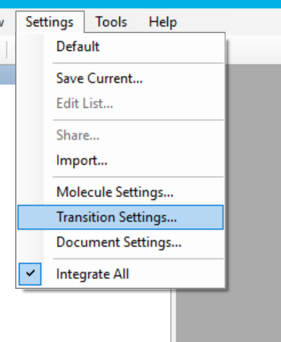
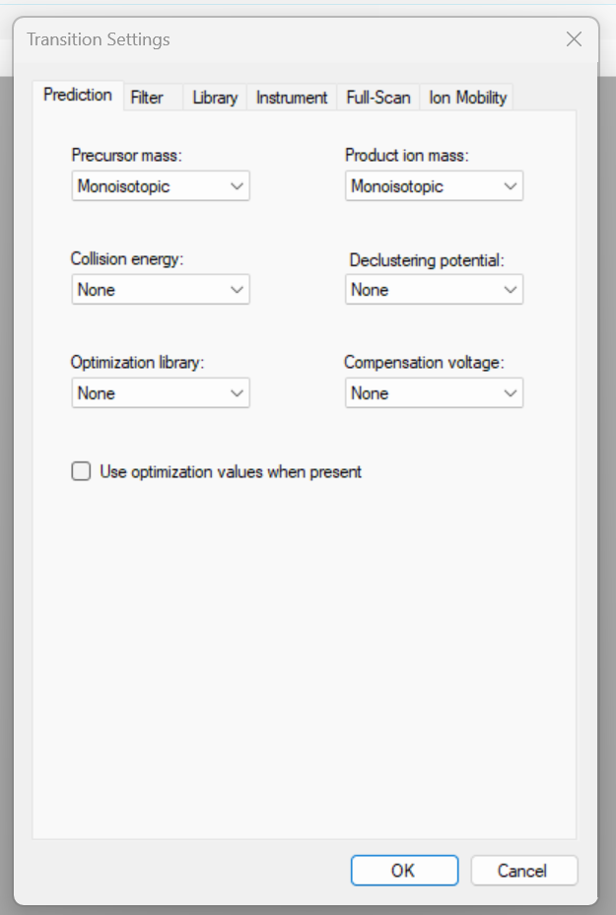
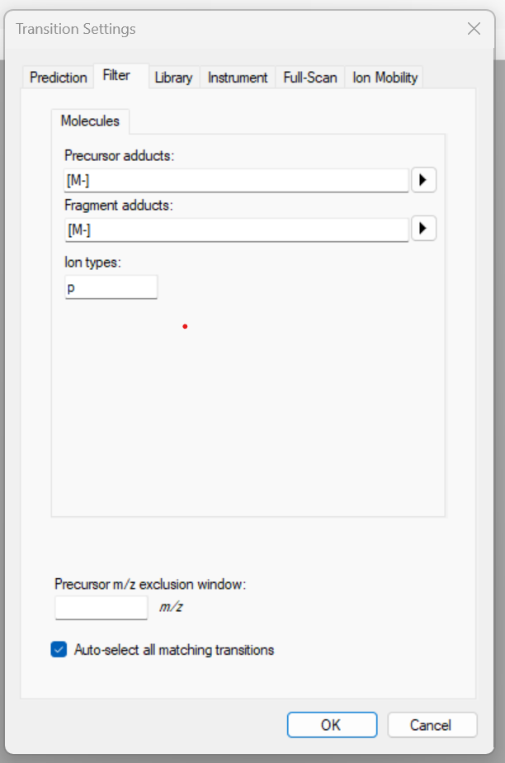
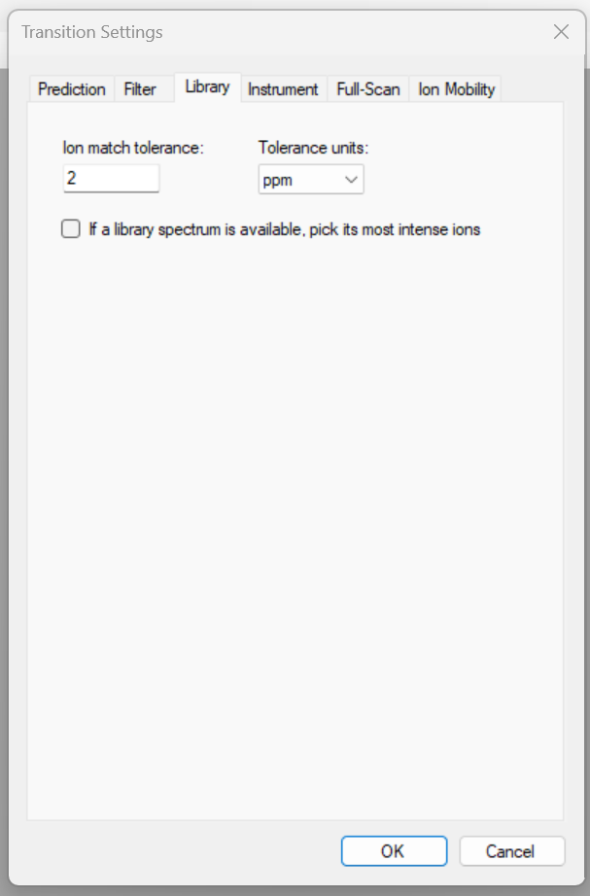
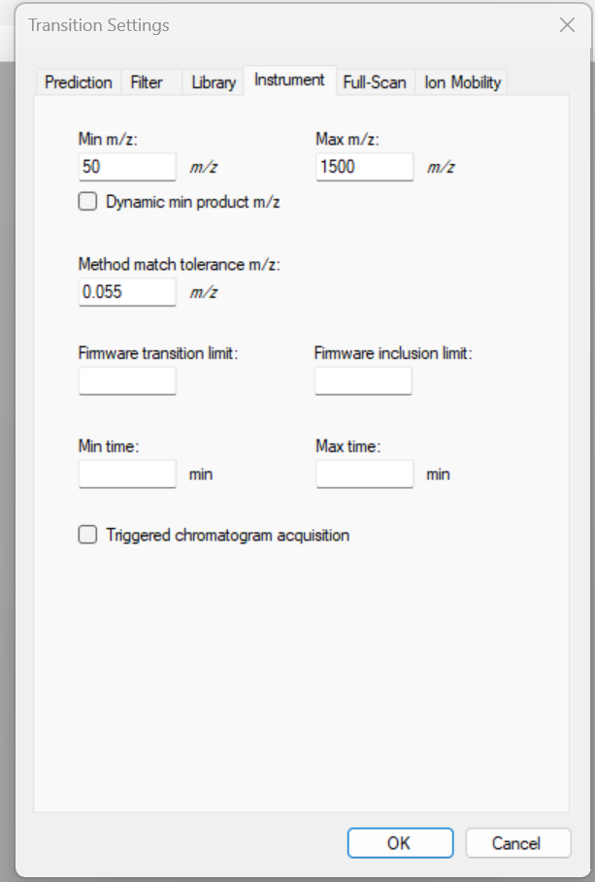
CPxplorer
Skyline
INTEGRATE THE DATA
The user can modify the instrumental parameters at the “Setting” -> “Transition setting” window. Below are some instructions.
…
The transition list generated by CPion contains several ions corresponding to different isotopes of each molecule. Therefore, the “precursor mass” and “product ion mass” can be both set as “monoisotopic”
CP mixtures are analyzed only using MS1 data. Consequently, the “Collision energy”, “Declustering potential”, and “Compensation voltage” can be set as “None”.
Not available library
The adducts were already selected in CPion, and they are included in the transition list. So, the “Precursor” and “Fragment” adducts can be set as [M-] and [M+] when applying a negative and positive ionization technique, respectively.
“Ion types” can be set as “p” (parent) when only MS1 data is used
Since a spectral library is not used keep the library box unselected
m/z range from the scan used for acquiring the data
Mass error acceptancy when extracting the chromatograms. 0.005 and 0.010 are recommended for Orbitrap and qToF data, respectively
The firmware is not needed when using MS1 data solely. It is a multiplexing strategy for data-independent acquisition (DIA)-based mass spectrometry data,
6

Slide 9
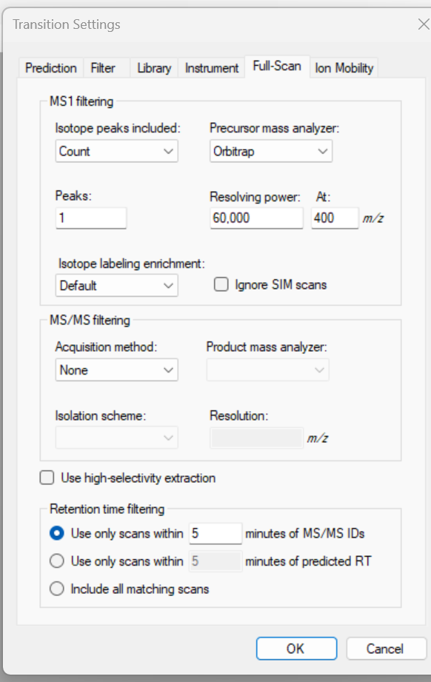
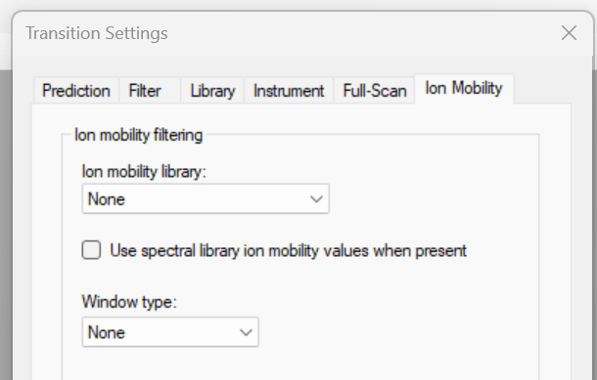
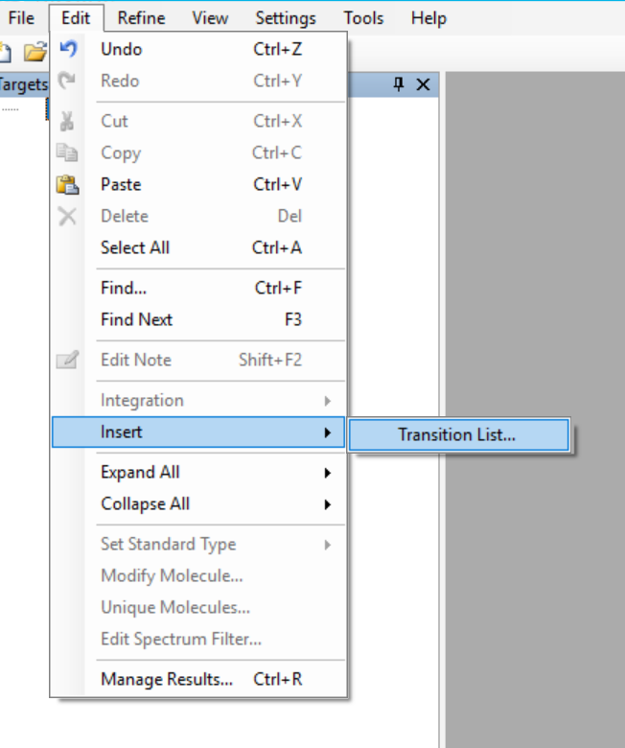
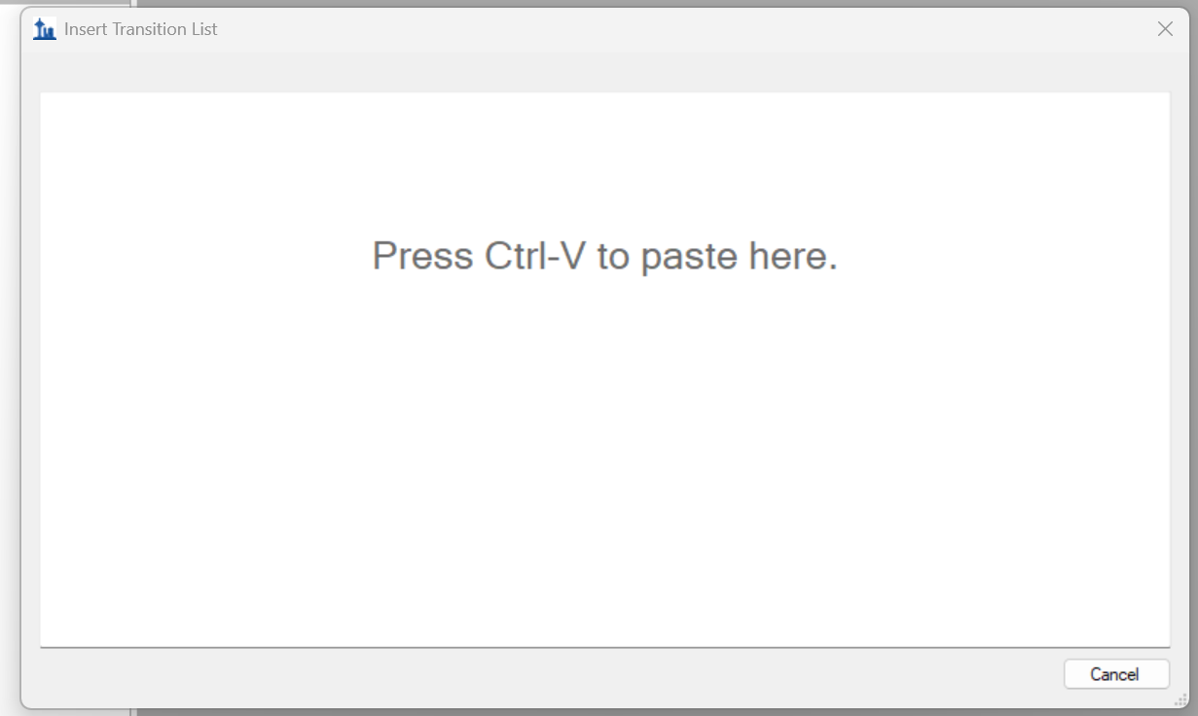
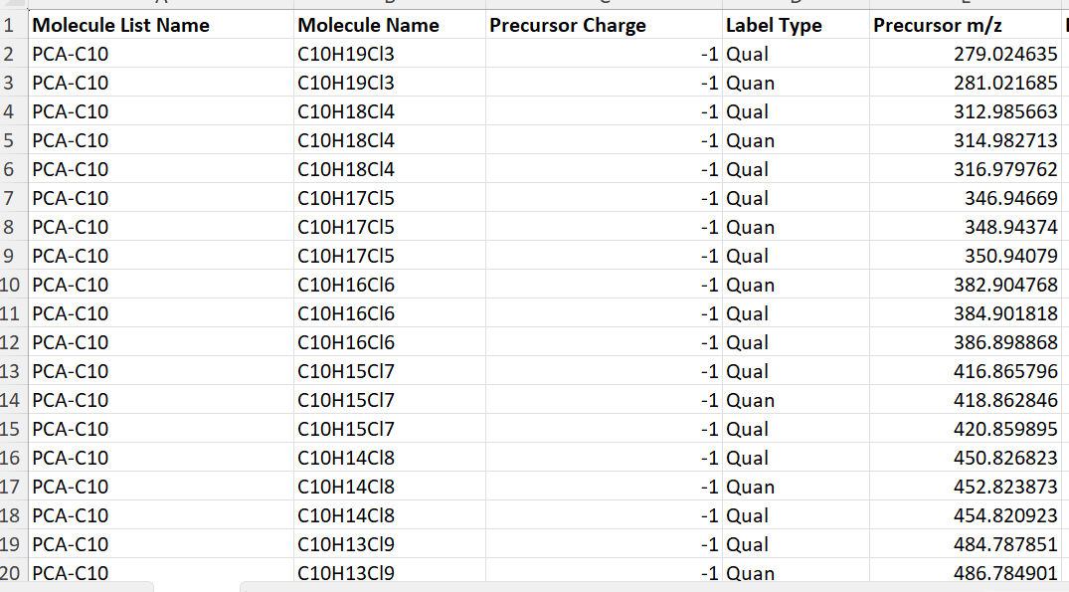
CPxplorer
Skyline
INTEGRATE THE DATA
The "Count" option can be selected, to get a specific value for each "Peaks“
Selecting the instrument used will prompt Skyline to extract chromatograms from profile data, summing all profile intensities across an m/z range within the specified mass resolution
The instrumental resolution used for acquiring the data
The isotope labeling can be set as default because it was already indicated in the “Molecule setting”
Set a broad window, ex.: 5 min
When only MS1 data is used the “MS/MS filtering” can be set as “none”
If the data also includes an ion mobility dimension, the library and window type can be indicated
Once the settings are introduced, the transition list can be imported
Copy the transition list that was exported from CPion into Excel, and paste it into Skyline
7

Slide 10
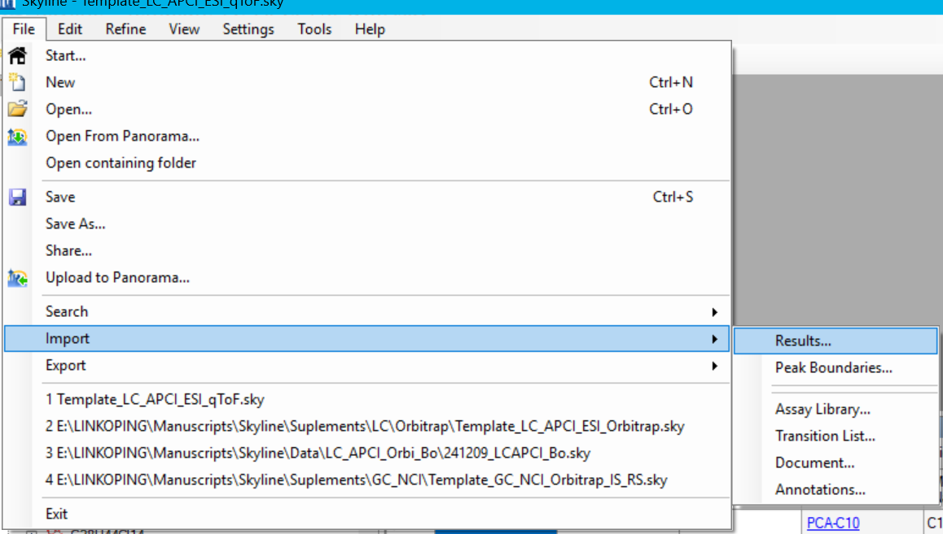
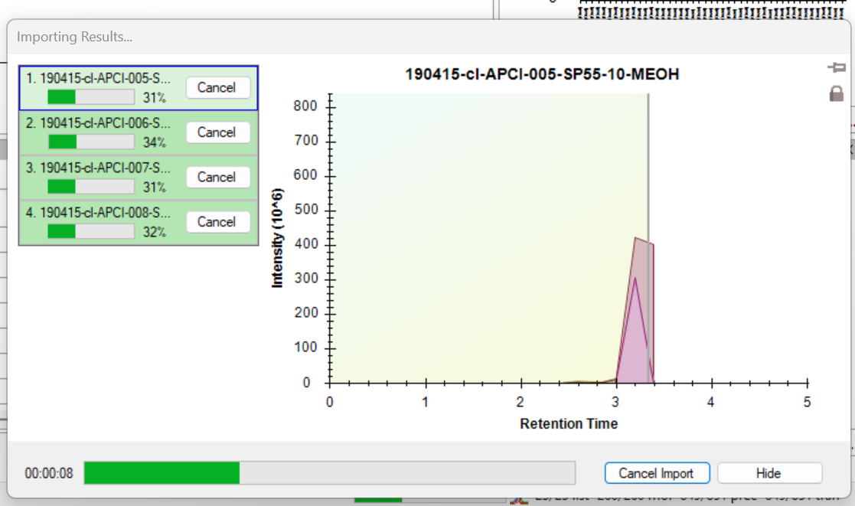
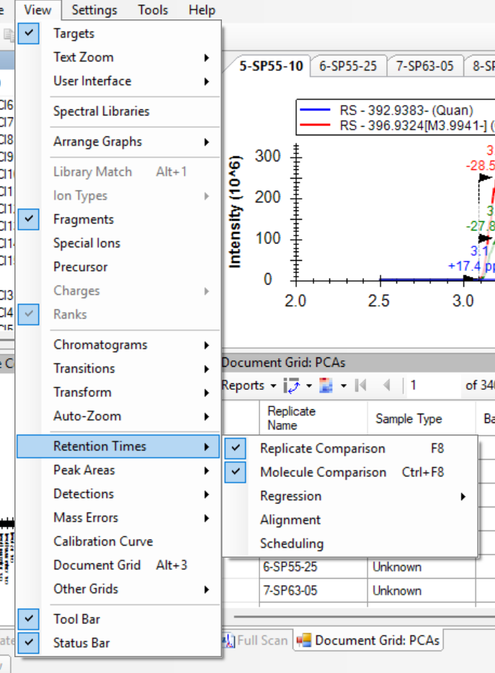
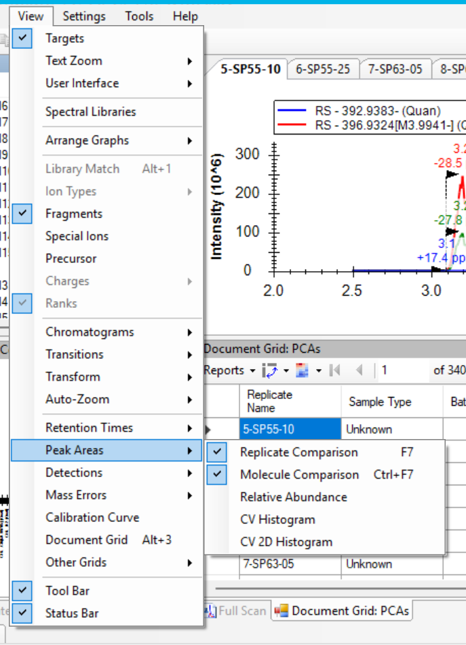
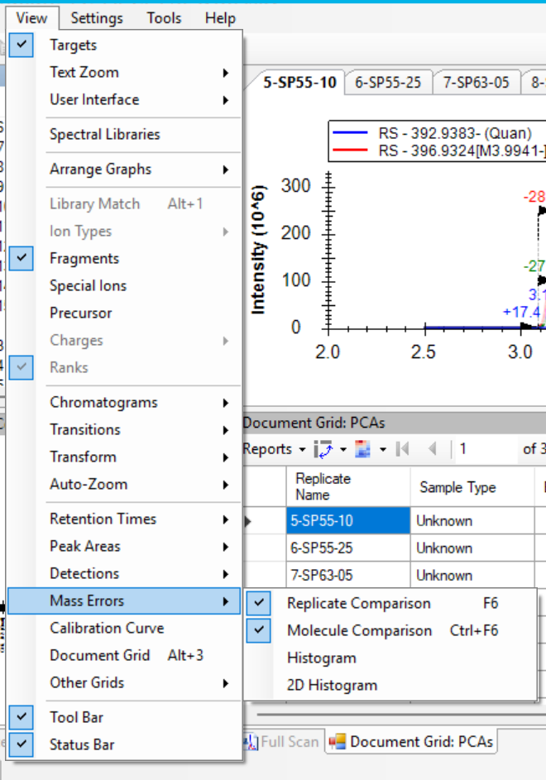
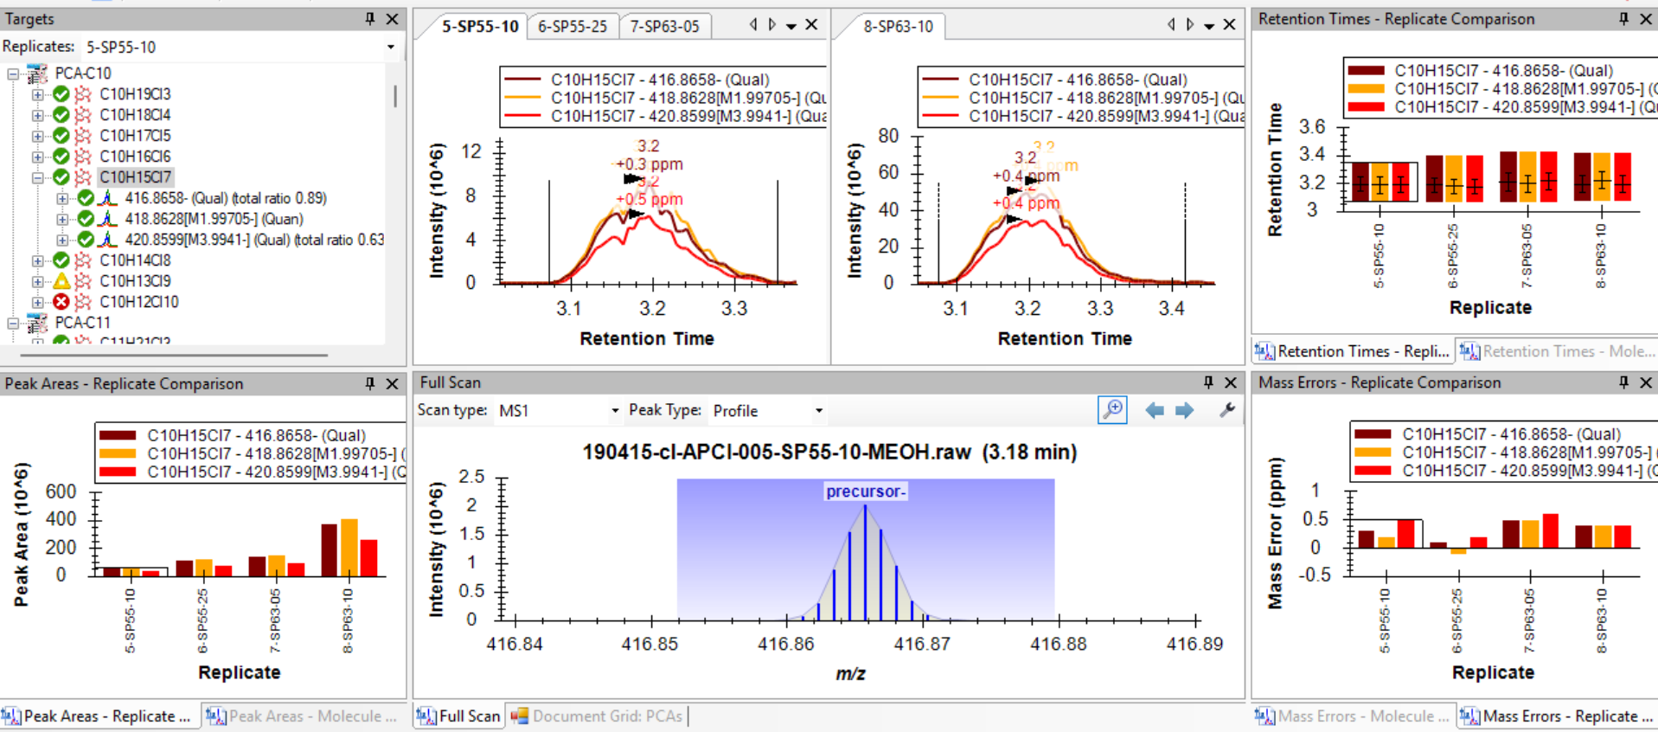

CPxplorer
Skyline
INTEGRATE THE DATA
Once the settings are set, the method can be saved and the raw data imported. Skyline supports major MS vendor raw files as well as .mzml format. without prior data conversion.
For the peak integration, the CPxplorer workflow advises verifying several parameters, including retention time, isotopic distribution, mass error, and m/z profile data distribution. Therefore, several panels are recommended to display in Skyline
The multiparameter display can be selected at the window “View”. The “Replicate Comparison” option displays the same Molecule for the different samples; while the “Molecule Comparison” shows all the molecules in all the samples
…
The display should look like the following:
Target list
Standard
Sample
Retention times
Chromatograms
Peak areas
Mass errors
It shows the isotopic distribution
The profile data will be displayed when clicking on the chromatogram of one of the ions
Note: when opening one of the methods available in the CPxplorer GitHub repository, the display appears automatically.
8

Slide 11
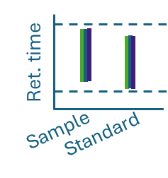
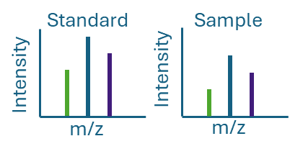
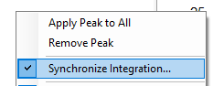
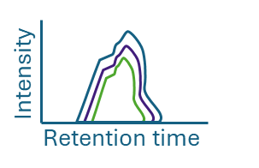
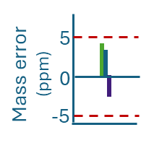

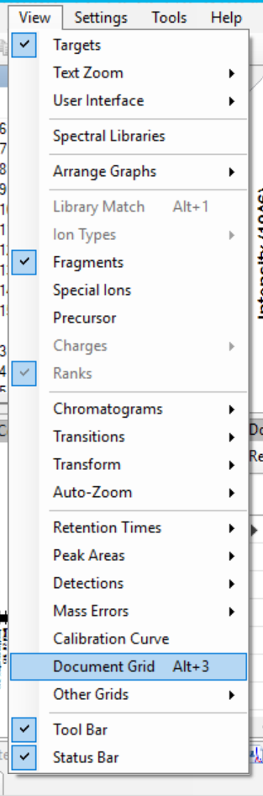
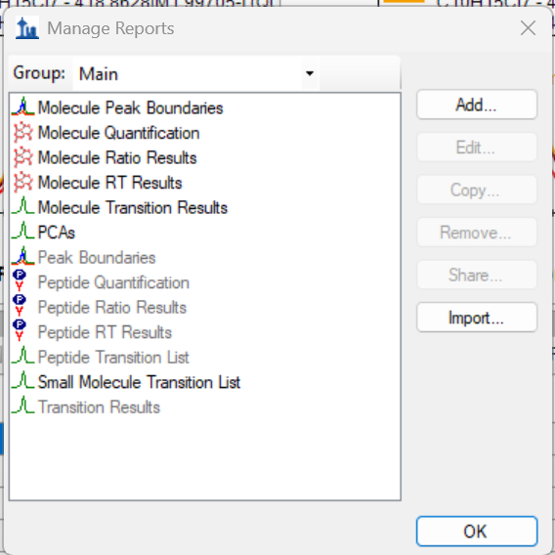
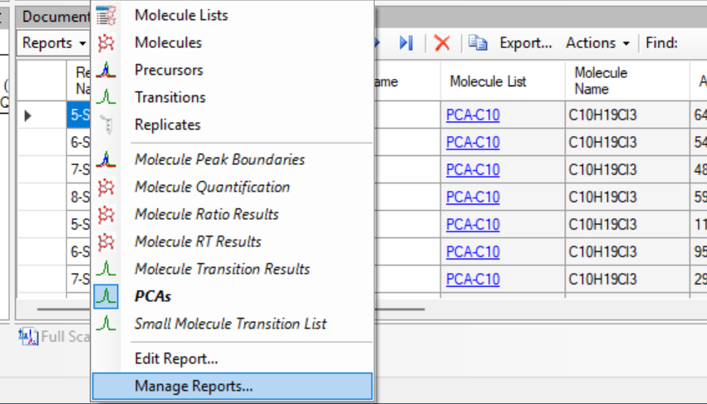
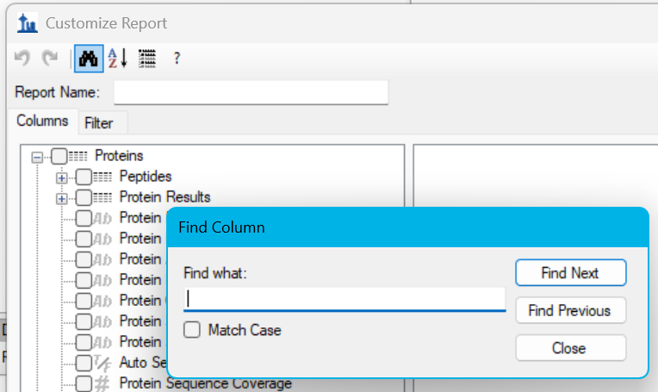
CPxplorer
Skyline
INTEGRATE THE DATA
Once the Skyline display is ready, the peaks can be integrated: The chromatograms of the different targets can be displayed by clicking on them in the transition list, and the peaks are integrated by selecting the start and end point of the chromatogram in the retention time axis. The following criteria is advised for selecting the data:
Example:
- Retention time:
- Peak area:
C₁₈H₃₁Cl₇: target m/z
528.9910 (qual)
530.9880 (quan)
532.9851 (qual)
Synchronize the integration of several files by right-clicking on the chromatogram:
Same retention time range for the standard and the sample
Same isotopic distribution for the standard and the sample
- MS profile data:
- Chromatograms:
- Mass errors:
MS profile data showing Gaussian distribution
Same peak shape for all isotopomers, the “quan” and “qual” ions
For Orbitrap data less than ±5 ppm, and for qToF ±15 ppm
The integrated data is compiled in the “Document Grid”, this is a report that can be edited by the user while treating the data simultaneously. It can be displayed in the “View” window:
…
A new report can be created in the Document Grid at the “Report” display, by “Manage Reports” and then “Add” a new one
Short cut for including new parameters in the report
9

Slide 12
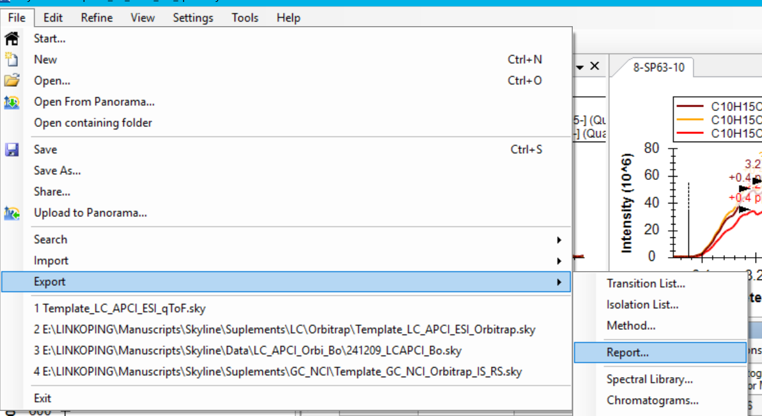
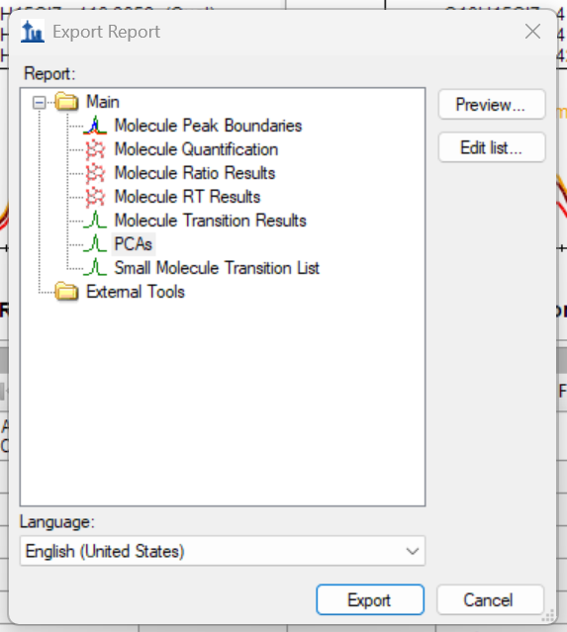
CPxplorer
Skyline
INTEGRATE THE DATA
In order to be able to integrate the report of Skyline into CPquant, the next step of CPxplorer, some parameters need to be included in the document Grid (Skyline report):
Replicate Name: This column will show the name of each file
Sample Type: This column must be filled in by the user. It indicates the type of file the data corresponds to, such as a sample ("Unknown"), standard ("Standard"), or blank ("Blank"), etc.
Batch Name: This column is used by CPquant to identify which files belong to the same standard and to know what type of standard they are. The batch name should indicate the chain length of the homologues present in the mixture (ex.: C10, C11, C12, C10-13, C14-17 etc.). The different files that belong to the same standard must have the same letter as a suffix. For instance, all the files belonging to the standard mixture SCCPs 51.5% Cl will have the Batch Name as “C10-13_A”, and the ones from SCCPs 55.5% Cl will have “C10-13_B”.
Molecule List: This column groups the homologues by chain length
Molecule: This column shows the homologues
Area: The integrated peak area
Analyte Concentration: This column shows the concentration of the different standard mixtures. It must be indicated by the user
Mass error PPM: The mass error of the measured m/z value to the theoretical one
Isotope Label Type: It displays the type of ion (quan/ qual)
Chromatogram Precursor M/Z: The theoretical m/z values
Ration Quan to Qual: The ratio between the quan and qual ions
Ration Qual to Quan: The ratio between the qual and quan ions
Once the report is finished, it can be Exported to Excel and used in the next module of CPxplorer: CPquant.
Select the report that was previously created in the Document Grid
10

Slide 13
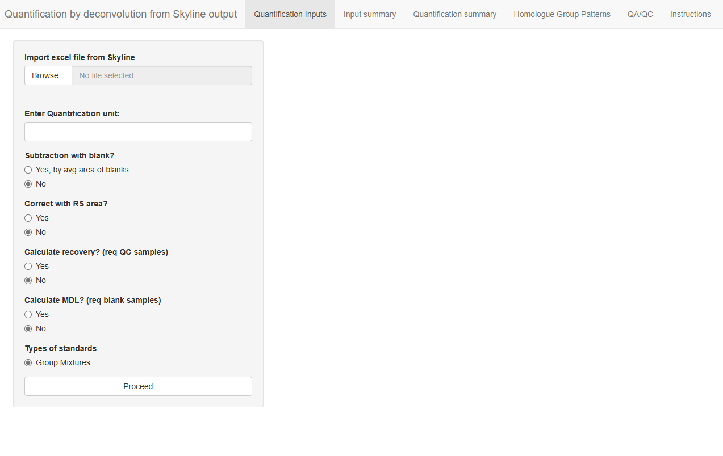
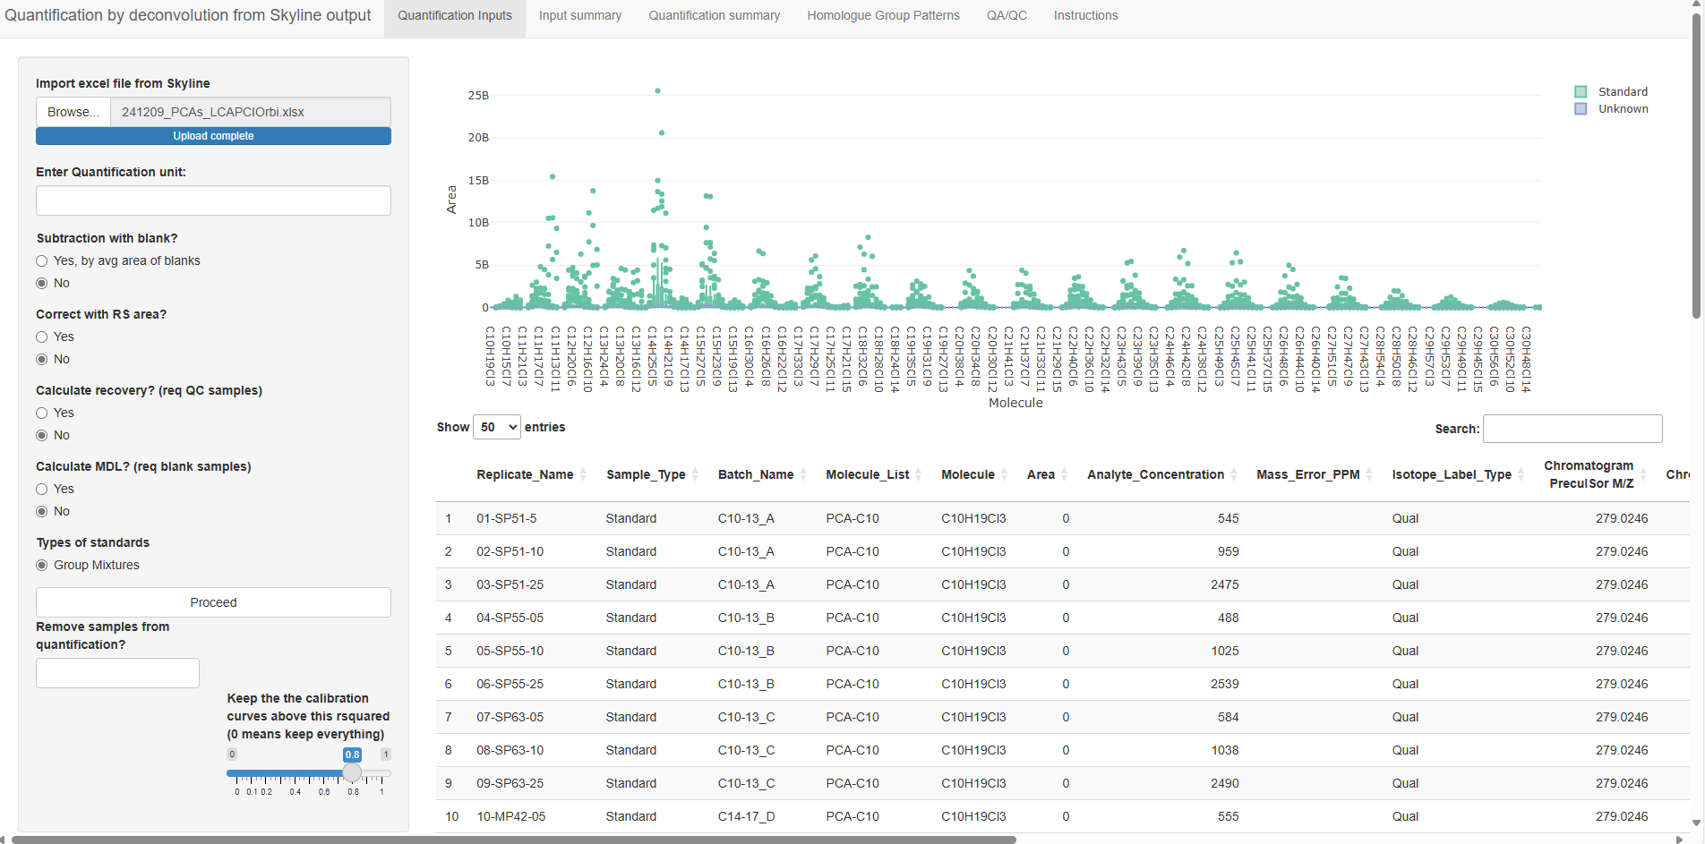
CPxplorer
CPquant
QUANTIFY THE DATA
CPquant is a module in the CPxplorer package. CPion is a module part of the CPxplorer package. It consists of an Rstudio based app whose code source can be found at https://github.com/WBS-TW/CPxplorer. A browser based interface is available at https://wbs-tw.github.io/CPquant_Shinylive/ which can be run in the local computer without installing the R shiny app.
CPquant is a tool for performing automatized quantification of PCAs. It is compatible with the report exported from Skyline and it does not require data adaptation.
CPquant performs the homologue deconvolution (Bogdal et al., 2015; Perkons et al., 2019)^{1,2}. Briefly, CPquant executes non-negative least squares regression to combine various standards and match them with the PCA pattern found in the sample. Note that CPquant performs the deconvolution on the “quan” ions from the Skyline input.
Upload the report from Skyline in .xlsx format
Indicate the unit that was used in the column “Analyte concentration” from the Skyline report (the quantification levels will be in this unit as well)
CPquant will calculate the average of the signals of the blanks and subtract it from the signal of the samples
PERFORM QUANTIFICATION
This function offers the possibility to correct the instrumental signal of the homologues with the signal of a spiked standard. For this function to be available, a specific internal standard is labelled “RS” in the column “Molecule List” from the Skyline report
Exclude samples from being quantified
A calibration curve is built for each standard mixture, this bar offers the option to set a minimum R² of the linear regression
¹ Bogdal, C., Alsberg, T., Diefenbacher, P. S., Macleod, M., & Berger, U. (2015). Anal. Chem., 87(5), 2852–60. https://doi.org/10.1021/ac504444d
² Perkons, I., Pasecnaja, E., & Zacs, D. (2019). Food Chem., 298, 125100. https://doi.org/10.1016/j.foodchem.2019.125100
11

Slide 14
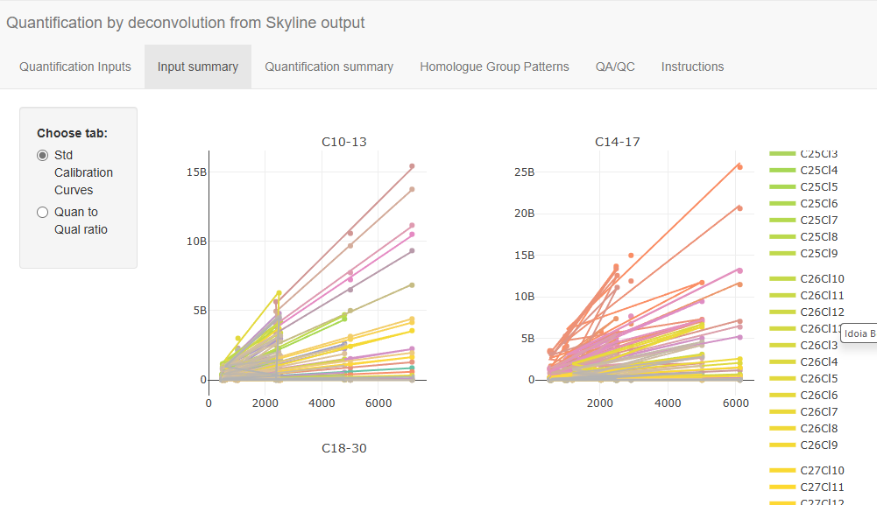
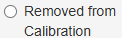


CPxplorer
CPquant
QUANTIFY THE DATA
The inputted data can be explored in the “Quantification Inputs” window. Here the data is displayed in an interactive graph and table:
Signal measured for the different homologues
Data imported from Skyline
The quality of the data can be further explored in the “Input Summary”
The tab “Std Calibration Curves” displays the calibration curves of the different standards for each homologue
Interactive graphs
Interactive graph
The tab “Quan to Qual” displays the ratio between the signal of the quan and qual ions
The tab “Removed from Calibration” displays homologue groups from standards that have R² lower than the set limit value, and are thus removed from quantification.
12

Slide 15



CPxplorer
CPquant
QUANTIFY THE DATA
The quantification results can be found in the “Quantification Summary”, more detailed information is displayed in the “Homologue Group Patterns” window.
Download the current view
Download the full quantification results:
SumPCAs
Deconvolution fit
Homologue concentration
SumPCAs
It shows how well the reconstituted pattern fits the one in the sample, where 1 would mean a perfect fit
The graph displays visually the contribution of each standard for building the reconstituted pattern in the sample
A visual comparison between the reconstituted and measured patterns can be displayed at the “Homologue Group Patterns” where the bar plot shows the measured relative distribution and the black dotted line the reconstituted one:
Select the sample(s) for display
13

Slide 16


CPxplorer
CPquant
QUANTIFY THE DATA
Several displays of the homologue patterns can be found in the “Homologue Group Patterns” window.
The inputted relative distribution of the homologues in all the samples can be displayed at:
The reconstituted relative distribution of the homologues in all the samples can be displayed at:
Select the sample(s) for display
The display shows several samples simultaneously and facilitates the comparison between replicates
14

Slide 17


CPxplorer
CPquant
QUANTIFY THE DATA
The “QA/QC” displays several parameters that serve to investigate the quality of the data.
“deconv_rsquared” shows the goodness of fit of the nnls model to reconstitute the homologue pattern of the sample
Download the report including the QA/QC results
MDL: Method limit of detection:
CPquant can calculate the method limit of detection (MDL). It determines MDL based on the signal of the blank, therefore in order to have the MDL feature available in CPquant the report from Skyline needs to contain the files for the blank.
MDL will be calculated according to:
If the signal was NOT blank subtracted (this is selected in the “Quantification inputs” panel, prior to deconvolution):
MDL = average of blank levels + 3 * standard deviation of blanks
If the signal was blank subtracted (this is selected in the “Quantification inputs” panel, prior to deconvolution):
MDL= 3 * standard deviation of blank samples
Recovery:
CPquant can calculate the recovery by using the signal of the internal standard. Therefore, the internal standard that is used for calculating the recovery needs to be named as “IS” in the “Molecule List” of the Skylilne report.
This feature is designed for a data set that contains a refence standard with the same internal concentration as the samples. This standard will be assigned as “Quality Control” for the “Sample Type” in Skyline. CPquant expresses the recovery as the ratio between the sample and the "Quality Control".
CPquant considers the signal of the “Quality Control” as a 100% recovery and calculates the ones in the sample accordingly. If the Skyline report contains more than one “Quality Control” CPquant will consider the average of their signals for the recovery calculation.
Note: If the in “Quantification inputs” panel “Correct with RS area” is selected as “YES” the signal of the internal standard used for recovery calculation will also be corrected.
15

Slide 18

CPxplorer
https://github.com/WBS-TW/CPxplorer
OVERVIEW
CONTACT INFORMATION:
idoia.beloqui.ezquer@liu.se
thanh.wang@liu.se

Slide 19



GOOD LUCK WITH THE DATA ANALYSIS!
Please contact our team if any questions
CPxplorer
https://github.com/WBS-TW/CPxplorer
A platform-independent toolkit for rapid quantification and harmonization of polychlorinated alkanes
Idoia Beloki Ezker
Thanh wang
Ph.D. student
idoia.beloqui.ezquer@liu.se
Professor
thanh.wang@liu.se
Department of Physics, Chemistry and Biology (IFM), Linköping University, Sweden

